Slide 1

Movie app
Creators: Juho Ylöstalo, Joni Sirviö, Krister Rajaniemi, Tino Vuori
Welcome to the presentation of our project called MovBee

Slide 2
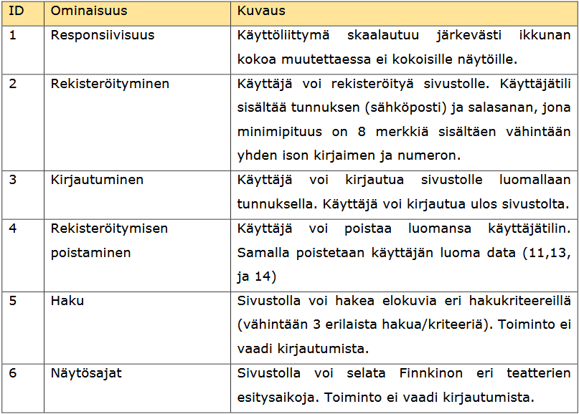
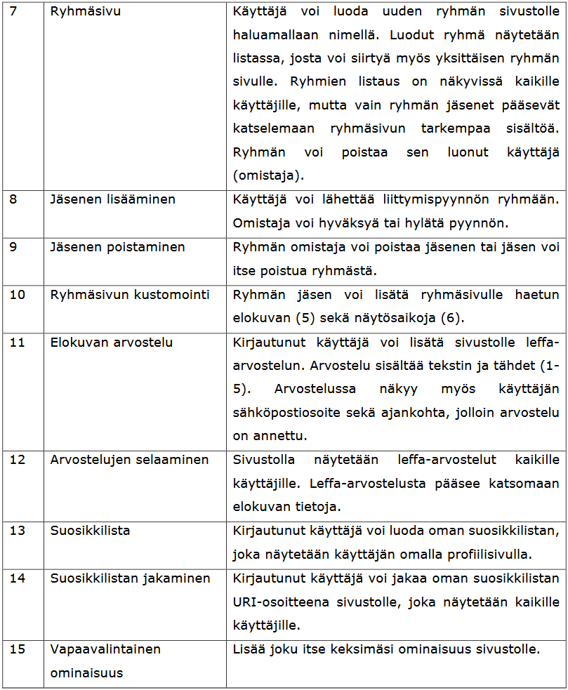
We have every feature and got everything working from the list, and our optional feature is movie recommendations on the “movie card” page seen later.

Slide 3

What is a movie app you might ask?
Users can browse the basic functionalities of the site without signing up
Movie search and presenting times are available for all users
After signing up, users can add movies and show times to favourites and use the site’s group functions
All necessary data is saved in the database

Slide 4
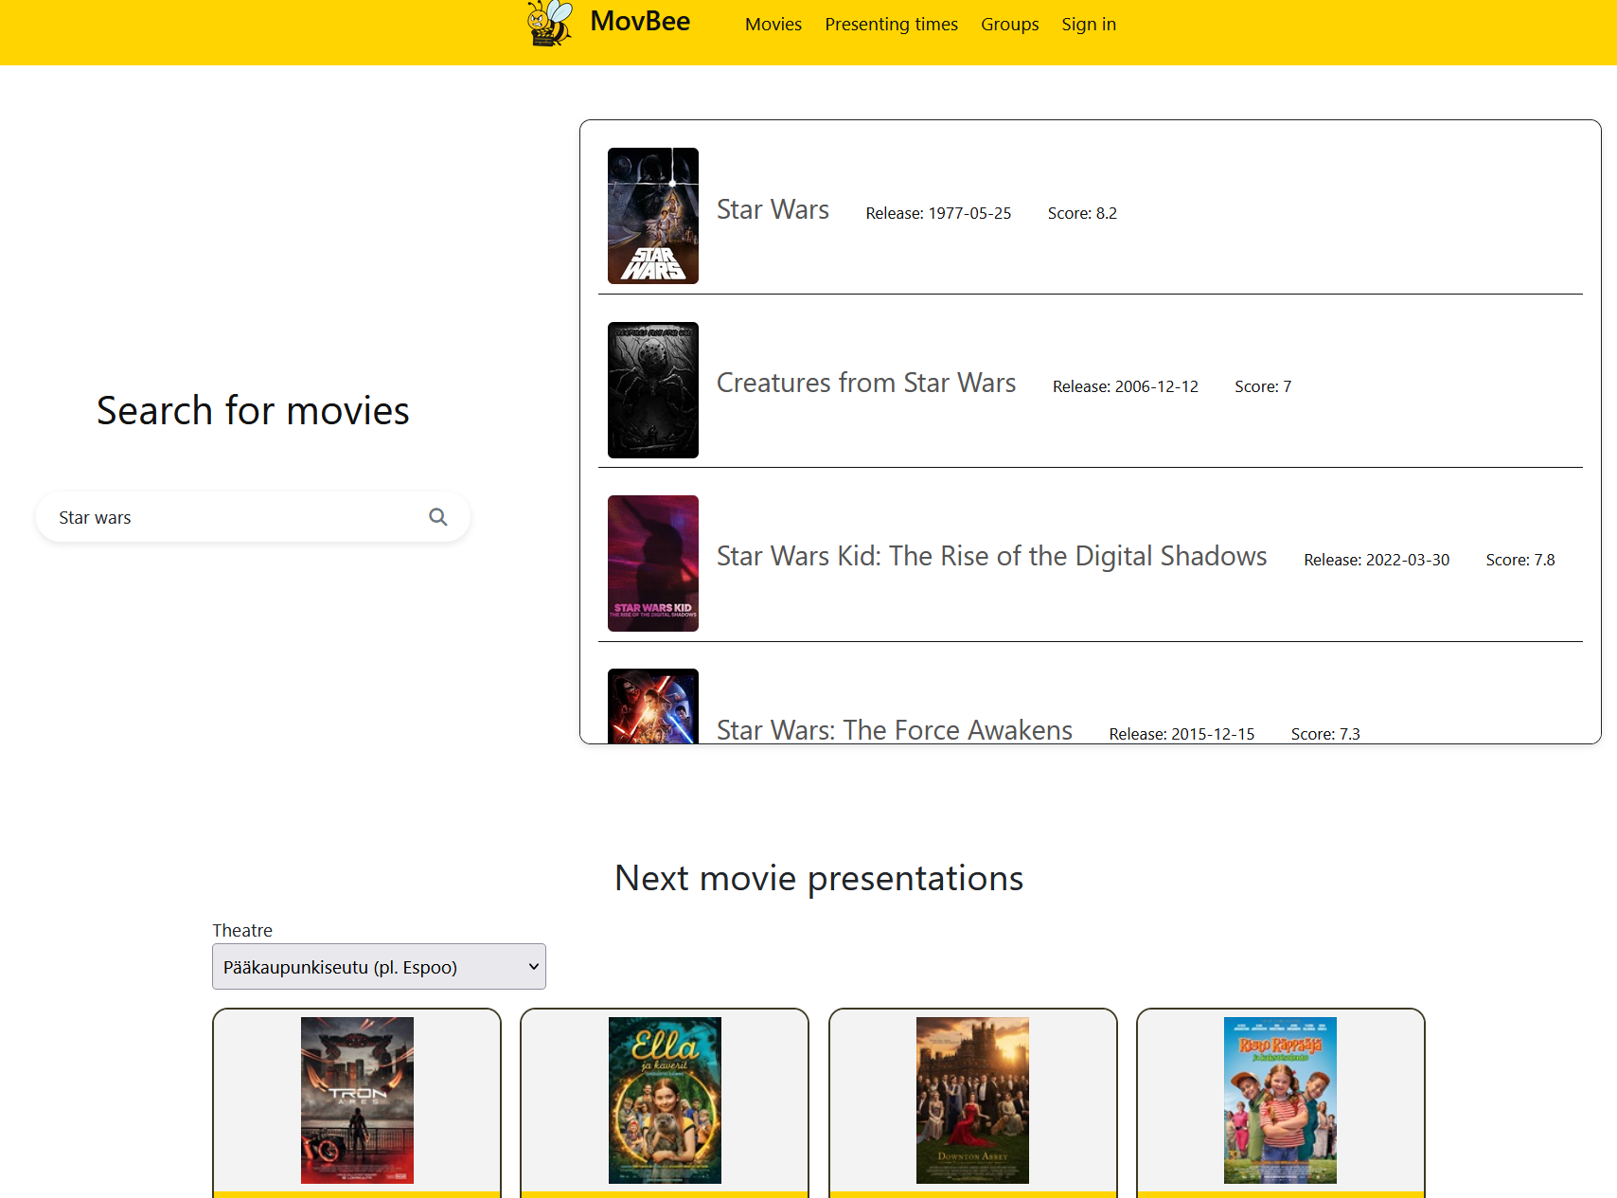
“Landing page” is where the site opens, showing movie search and upcoming movie presentations based on the chosen location

Slide 5
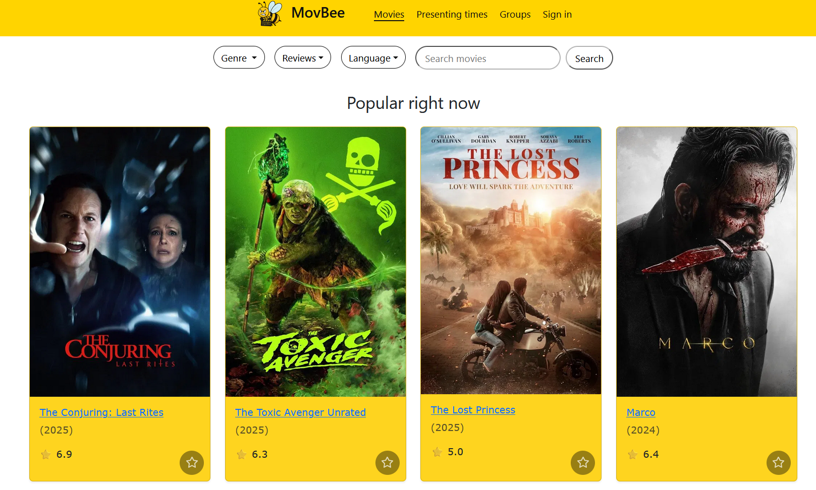
“Movies page” shows popular movies upon entry and you can look for a specific movie or by different criteria
Load more button is located at the bottom of the page that loads more movies based on current search criteria
After signing in, users can add movies to favourites from the star icon

Slide 6
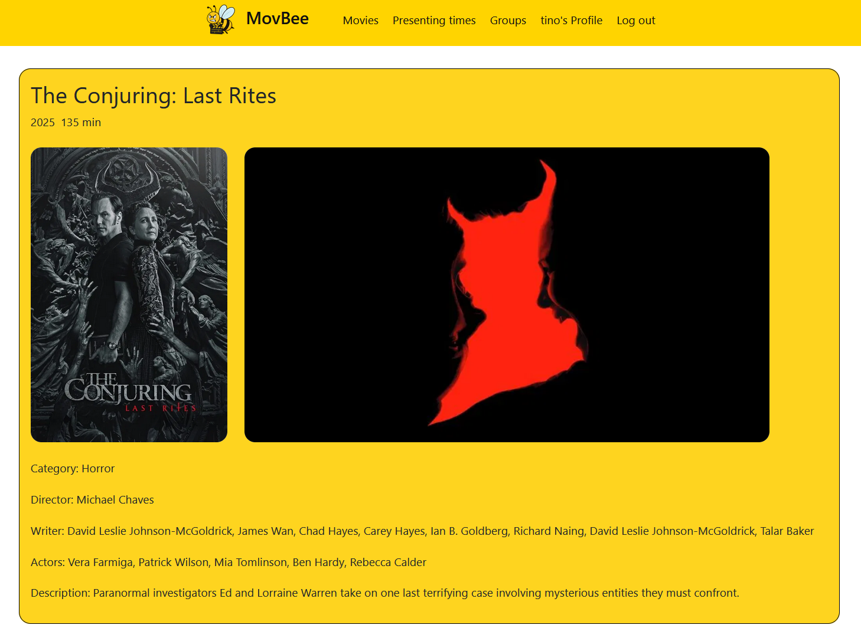
Users can click on the movie title and that leads them to see more details about the chosen movie as seen on the right
For example category, director and actors
Doesn’t require signing in

Slide 7
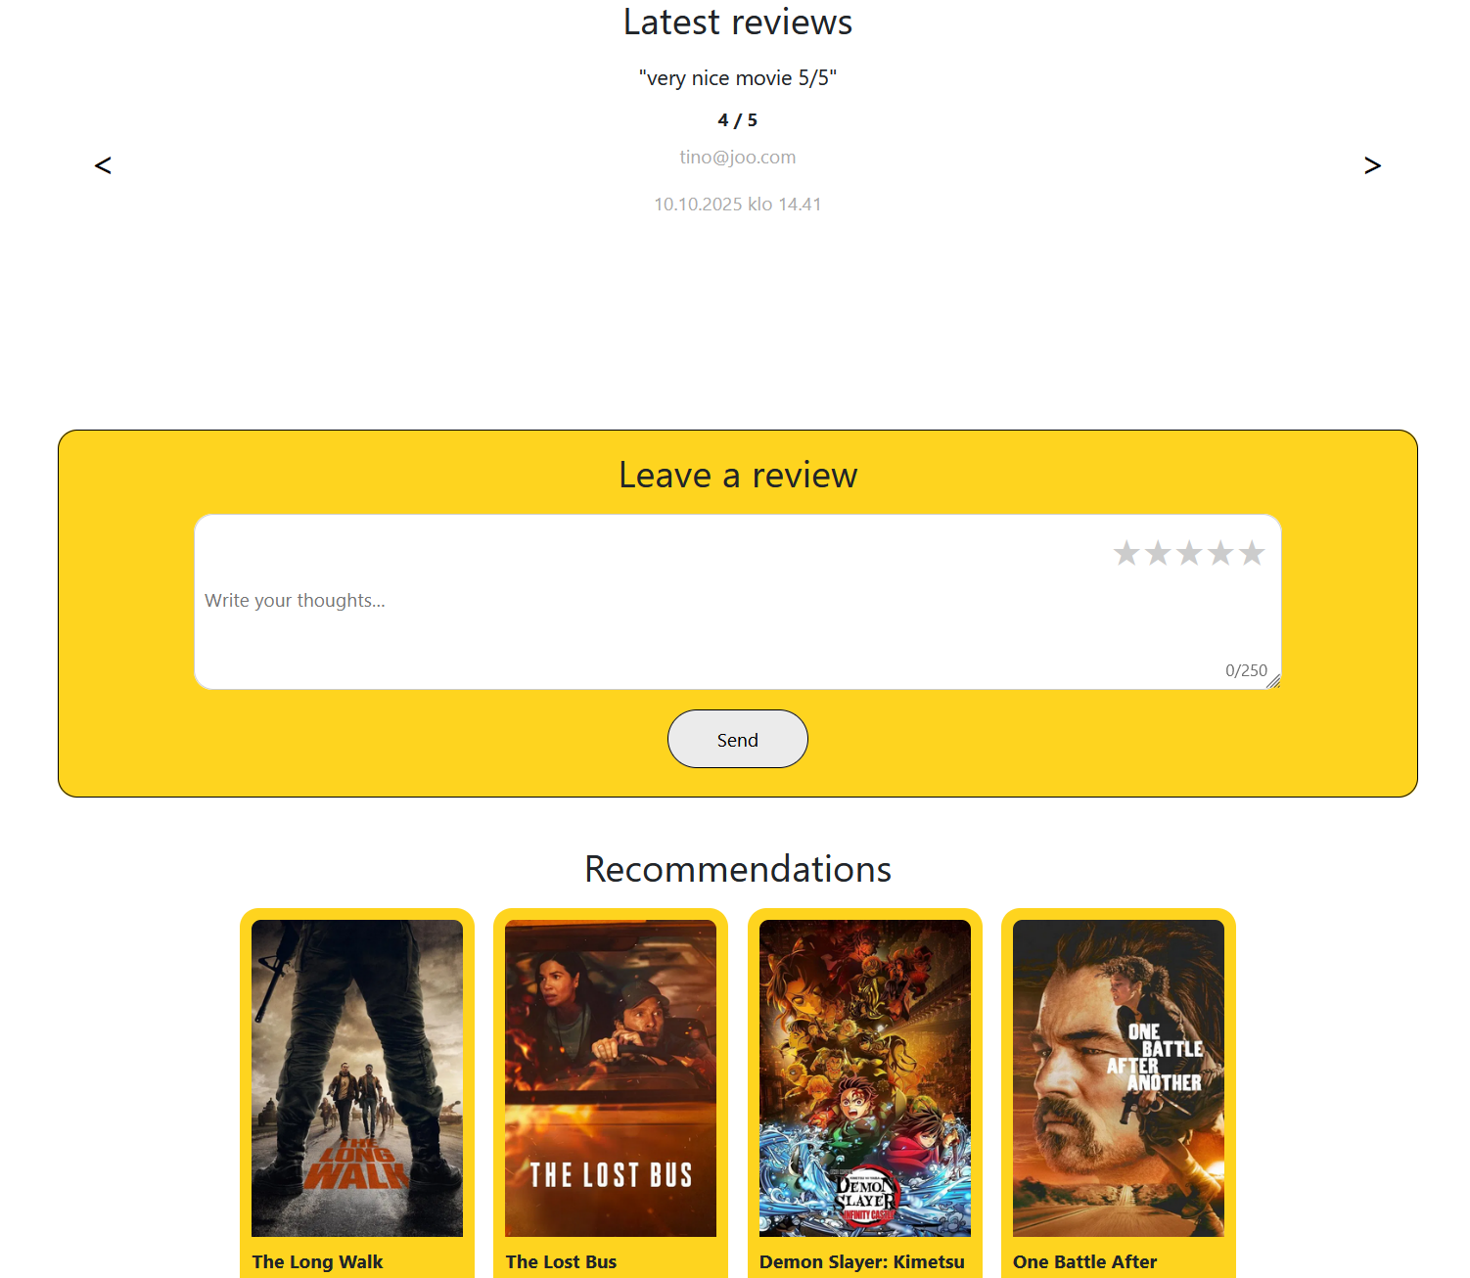
Under the movie details, users can see reviews from other users and leave their own reviews
Leaving a review requires signing in, but anybody can see the latest reviews
Reviews are saved in a database
Recommendations as the name implies recommend similar movies to the one you are looking for more info

Slide 8
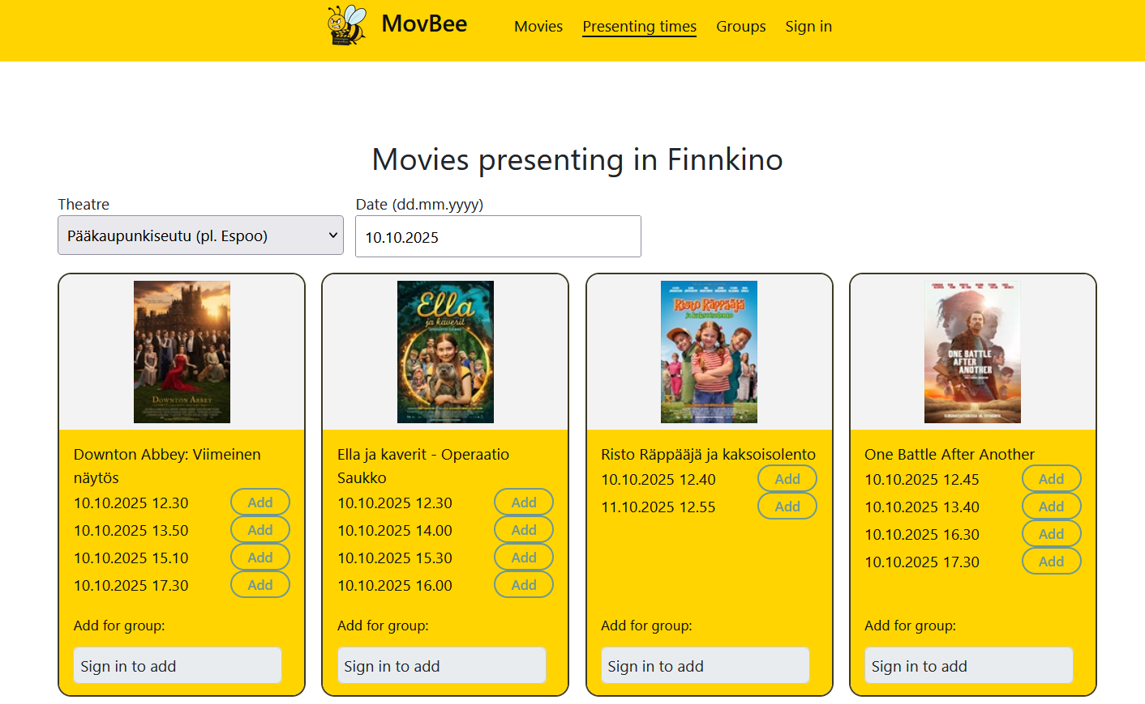
“Presenting times” page shows more movies playing in theatres with a show more button at the bottom that loads more movie showtimes
After signing in, users can add movies to the group they are in for other members to see

Slide 9
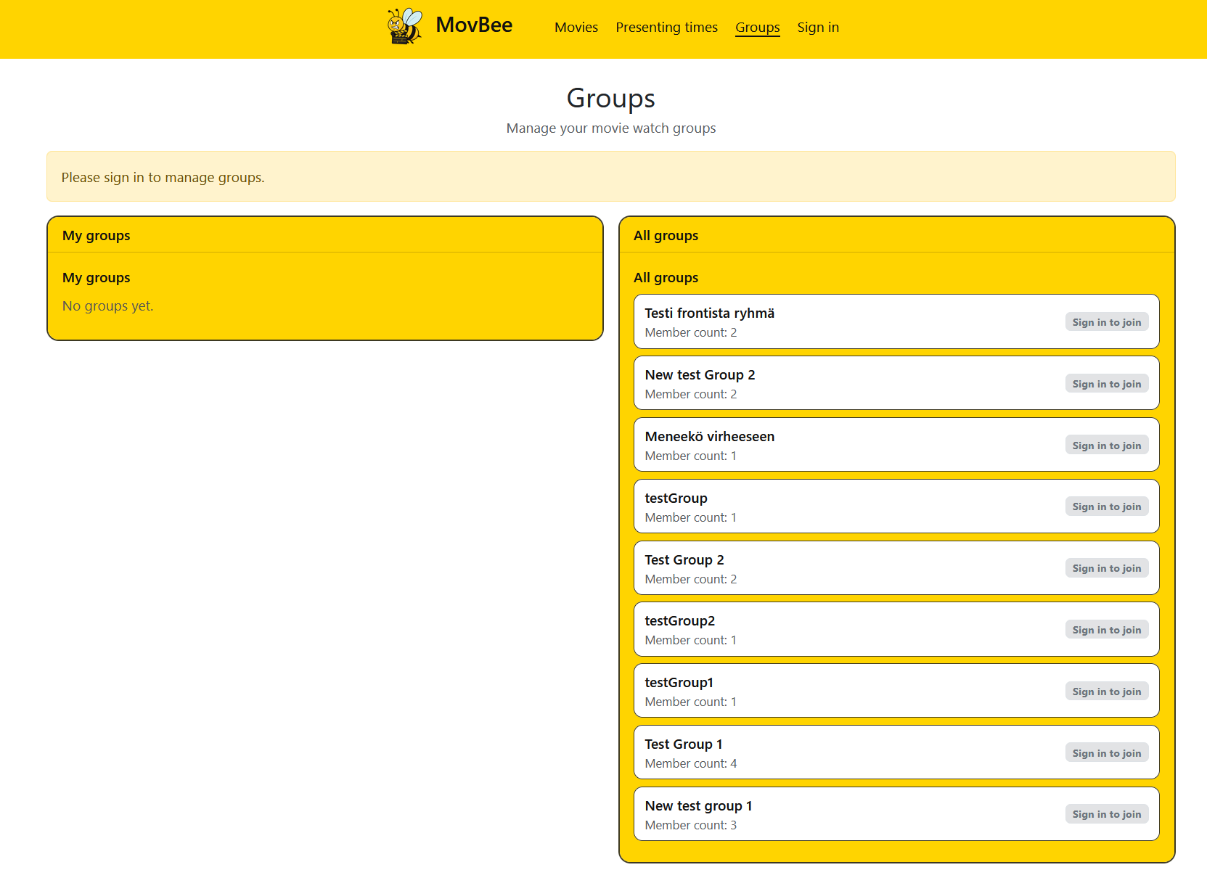
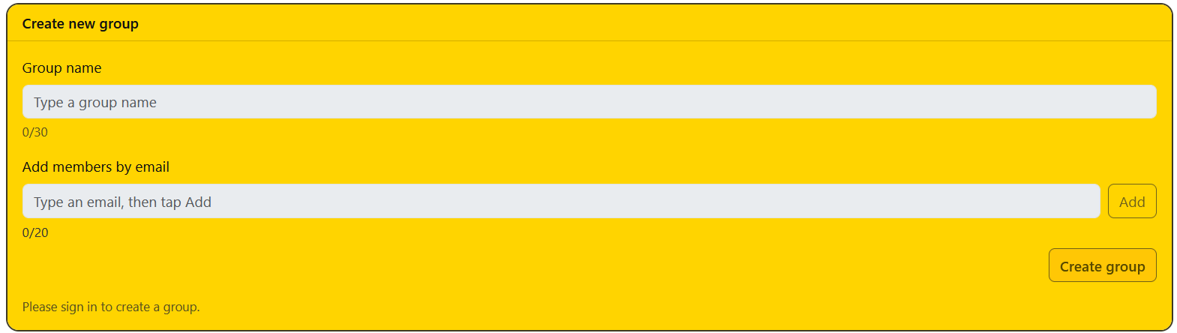
“Groups page” shows your created groups and all existing groups. All groups section also shows how many members are currently in a group
Bottom block is for creating a new group and inviting your friends by their email addresses
Users must be signed in to use group functions as it’s stated in the beginning of the page

Slide 10
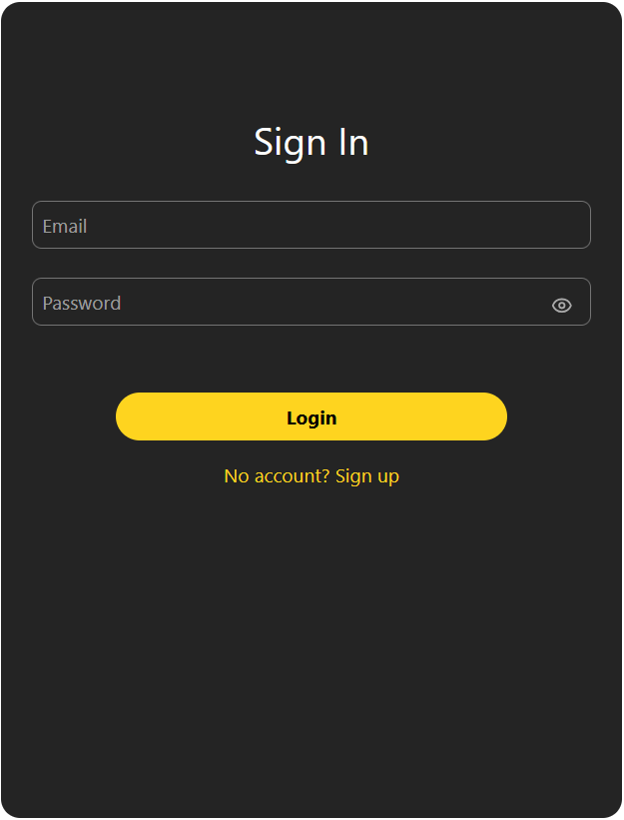
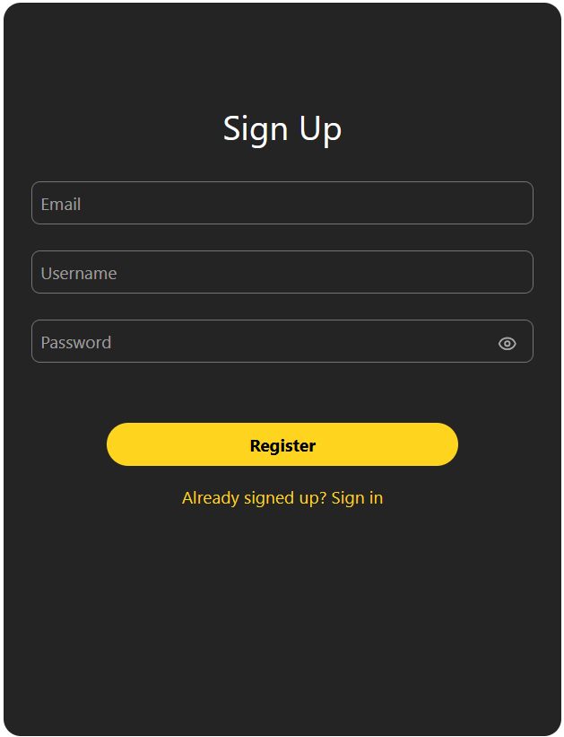
“Sign in” page contains a log in option, and if the user doesn’t have a signed-up account, then it’s possible to create one
Created users are saved in a database

Slide 11
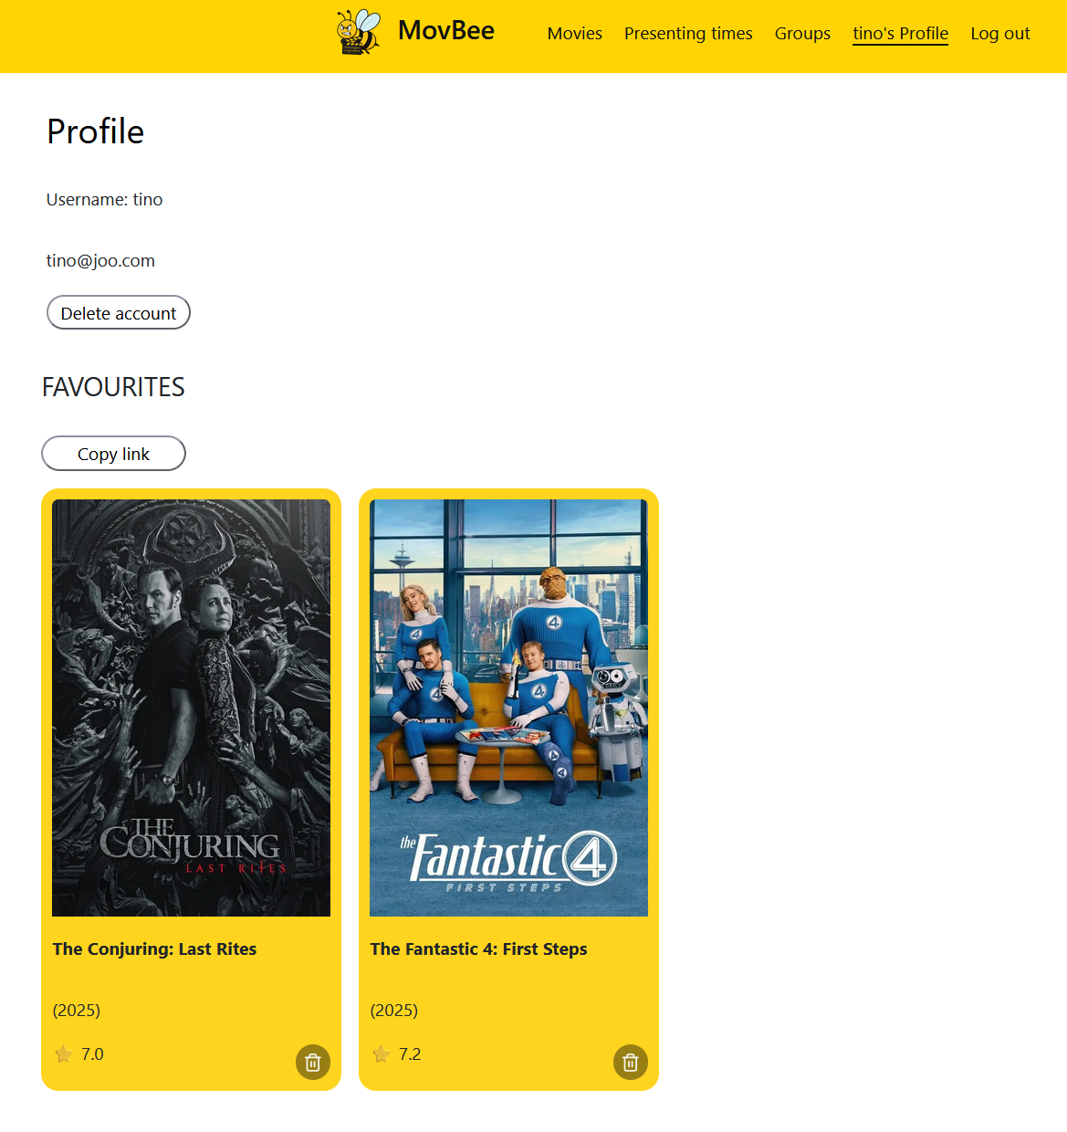
Users’ own profile page contains info from the account like username and email
Page shows your liked movies, you can delete them from favourites, or share with other users from the copy link button, which copies uri to the clipboard
Finally, users can delete their account, which deletes the account and all relations from a database

Slide 12
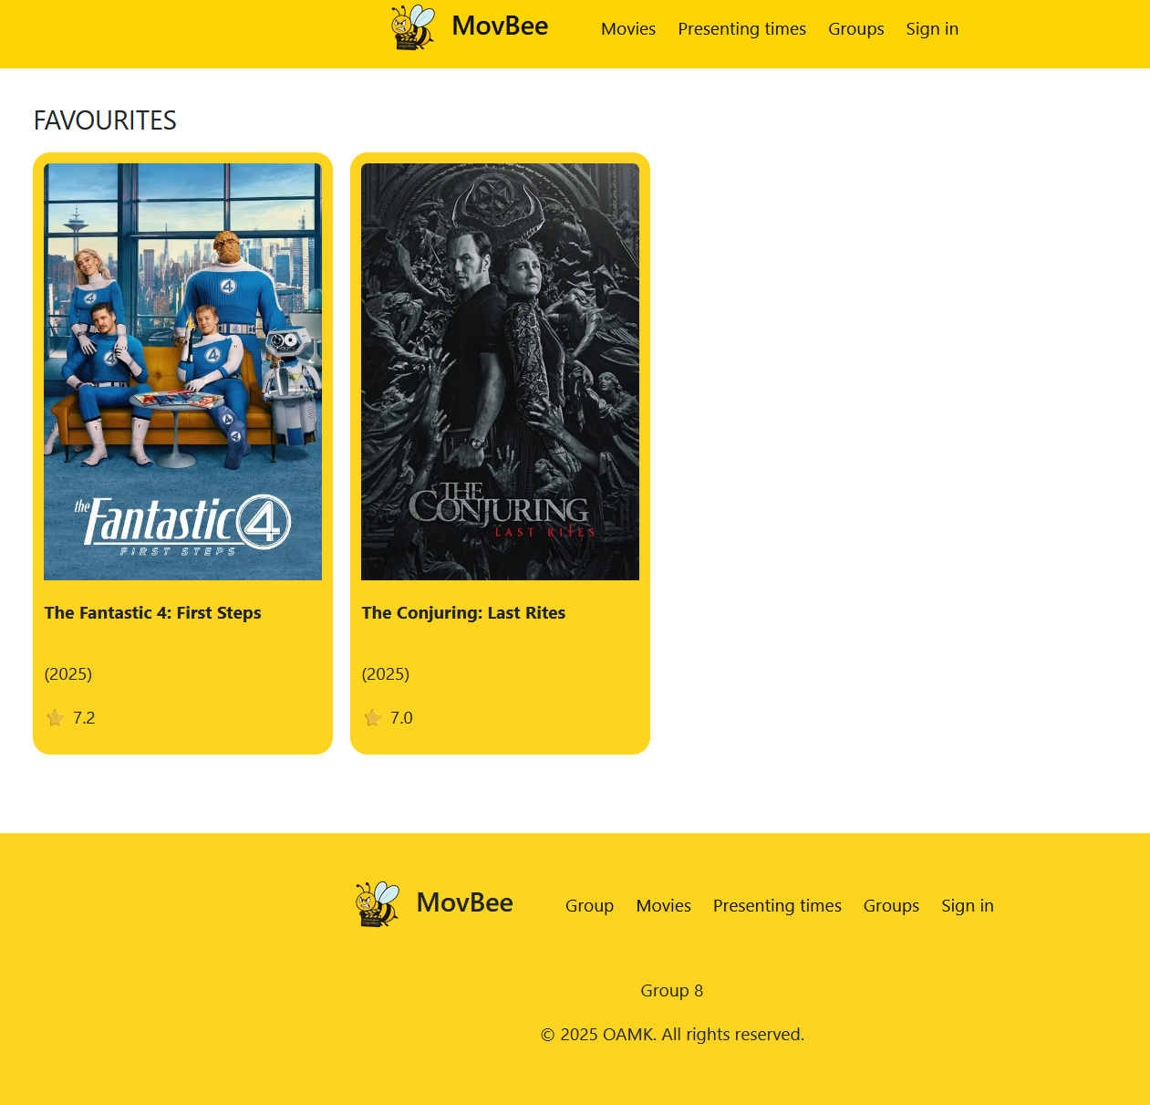
Here is an example from the link (uri) that users can send to other users
Here is also the footer that is on every page

Slide 13

What we learned
Almost every time, no matter how small the problem or addition seems to the project, it can take hours to finish

Slide 14
Success and challenges
Overall, the project was a success; we got everything working and the website looks nice and user-friendly
We learned a lot from React and its libraries
Couple things that make the user experience worse are that, for example, adding a movie to a group can only be done on the group page and show times can be added only from the presenting times page

Slide 15
Questions?

